Slide 1
Intermodulation Distortion
Pete Millett
ETF.19

Slide 2
Agenda
A little biography
What is intermodulation?
Single-ended triode amplifier transfer functions
Two-tone waveforms and FFTs
A special case: filament hum IMD
Listening demo

Slide 3
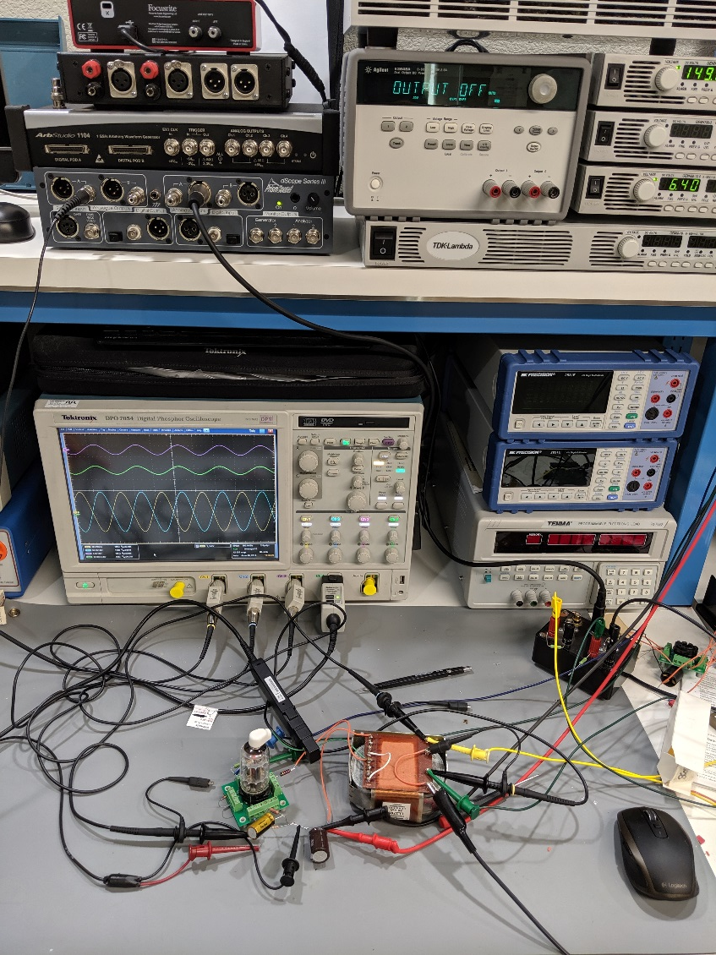
Biography
I’ve been coming to ETF since 2003
I’ve been an Electrical Engineer for almost 40 years, live in Colorado, USA and work from a lab in my home
Mostly a board level hardware guy in consumer and computers, but I’ve spent the last 15 years working for semiconductor companies
Have a hobby business doing DIY audio stuff
www.pmillett.com
pmillett@hotmail.com
Notes:
Testing a high gm driver (8608, like E55L with a top cap)

Slide 4
So, what is “Intermodulation Distortion”?

Slide 5
What is “intermodulation”?
In an ideal circuit, if you pass two single-frequency tones in, you get only those two tones out
Nonlinearities in a circuit cause the two signals to affect – or modulate – each other
The result is that there are tones in the output that were not at the input
The unwanted tones – intermodulation products – are mathematically related to the input tones
Notes:
I won’t dive into the math here, but basically the signals multiply with one another.

Slide 6
Why do we care?
We don’t usually listen to tones
Music is a very complex signal
However, you can imagine that the sound of one instrument might intermodulate with the sound of another
Think of a loud bass note and a flute
Generally IMD “muddies up” the sound or makes it sound harsh
IMD measurement is regarded as a more telling benchmark than THD measurements

Slide 7
Distortion in a simple triode amplifier

Slide 8
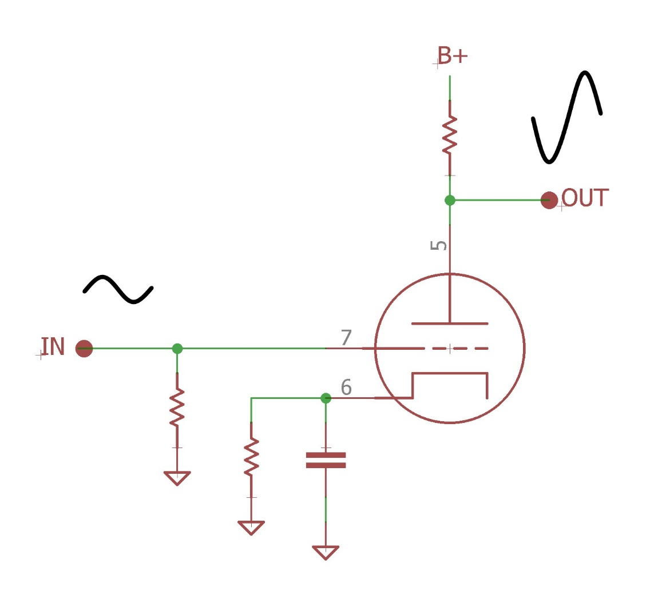
A simple single-ended triode amplifier
In a simple grounded cathode triode amplifier, the output signal is an inverted, larger version of the input signal
Ideally,
V_{OUT} = -V_{IN} * A + DC
Where A = voltage gain, and DC = the
static plate voltage (bias)
Note that this is a simple linear equation: y = mx + b. Remember high school algebra?

Slide 9
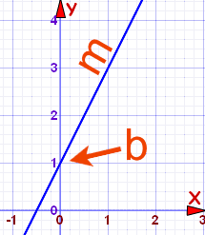
Transfer functions
If we make a graph of an ideal amplifier’s output vs. input, we get a straight line, whose slope is the gain of the amplifier
When we talk about “nonlinearities”, it is any deviation from this straight line that we are talking about – NOT the shape of the plate curves (though they are related, as you will recognize with experience)
You can easily construct the transfer function of a simple resistive loaded triode from the plate curves
Linearity varies dramatically for a given triode with differing operating conditions (bias point and plate load impedance)

Slide 10
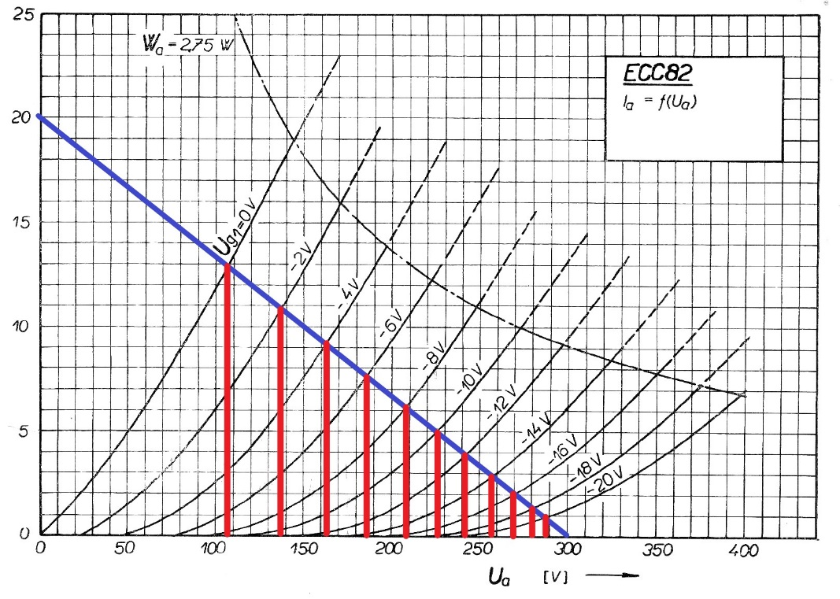
Transfer function of a real triode
This is an ECC82 with a 15k plate load resistor
Slope = 15k
Not a straight line! This is nonlinearity.
Notes:
You will notice that over a small area, especially at the high current end of the curves (near zero bias), the transfer function if fairly linear. This is typical of triodes – when operated closer to zero bias and at higher currents, they are more linear. This is also not an ideal operating point – tit would be better with more plate current.

Slide 11
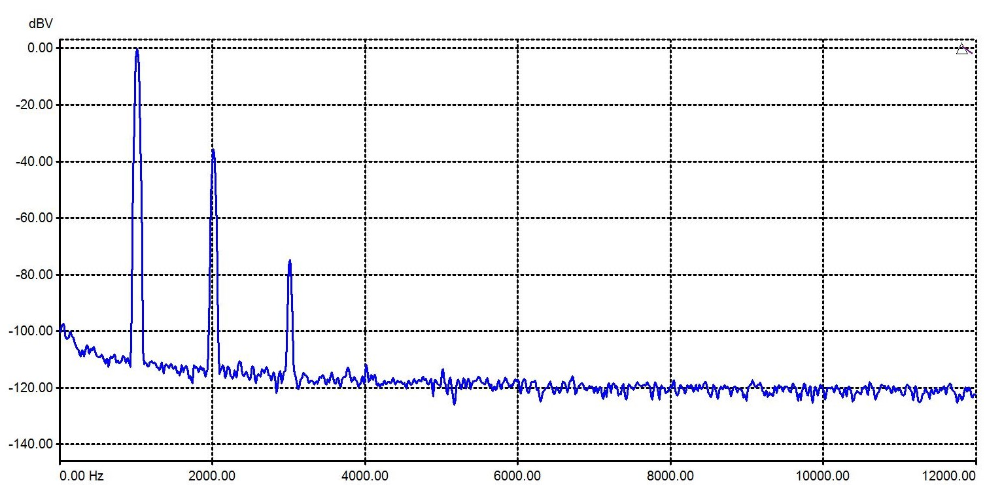
Single tone: harmonic distortion
When you apply a single frequency tone to this (not so linear) single-ended triode amplifier, you get harmonic distortion products
An FFT (Fast Fourier Transform) plot will show the distortion products, at multiples of the input
frequency
For more on harmonic distortion and FFTs, look up my ETF.04 presentation: http://www.pmillett.com/etf_sod.htm

Slide 12
Waveforms and FFTs

Slide 13
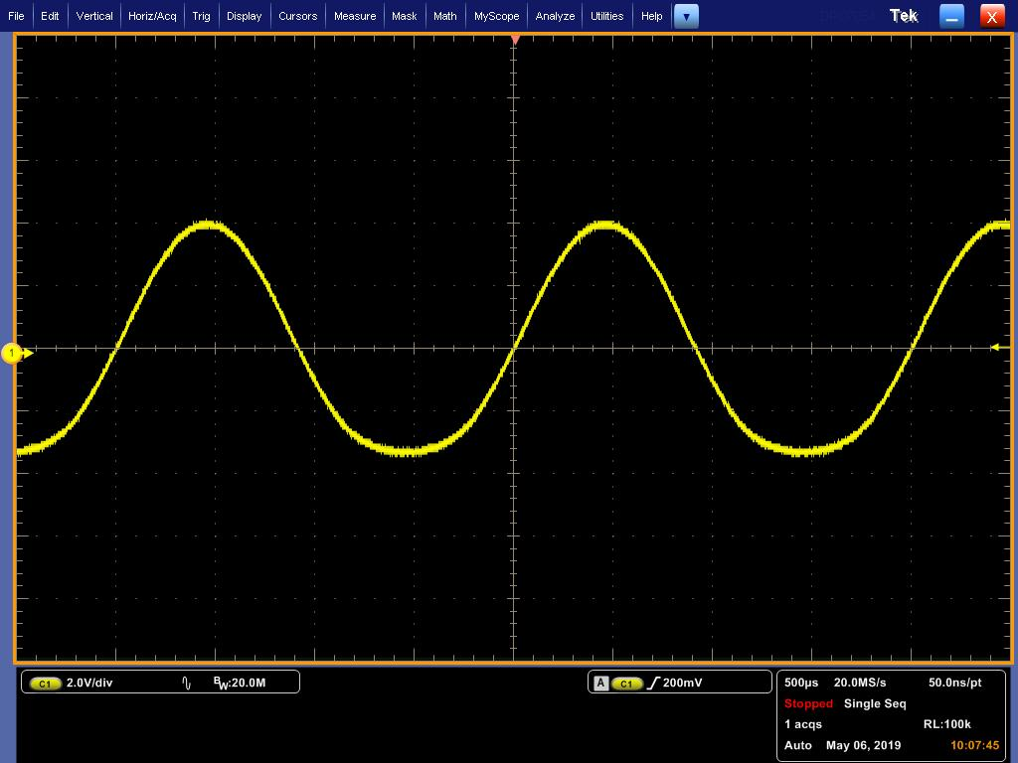
A bad amplifier
Here is an oscillograph of the output of a particularly nonlinear amplifier, with a 400Hz input signal. You can see the asymmetry – this is mostly even order harmonic distortion.
Notes:
This amplifier was intentionally biased near cutoff to generate lots of distortion. Don't do this! You can see the nonlinearities in the low frequency waveform – it’s not symmetrical. This waveform has lots of even order distortion – about 10% THD.

Slide 14
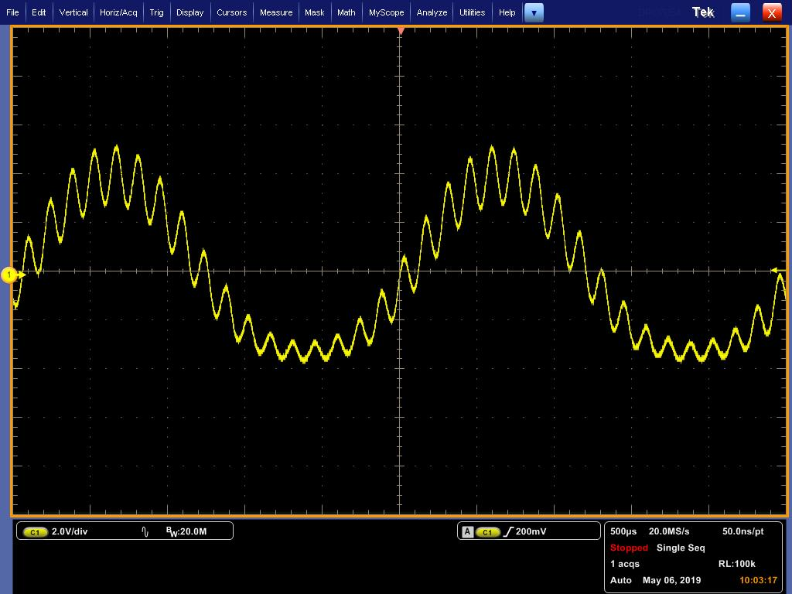
Two tones: intermodulation
Here is an oscillograph of a this same nonlinear amplifier, with a two tone input (400Hz and 7kHz)
The amplitude of the HF signal varies with the LF signal
Any amplifier with harmonic distortion will also create IMD!
Notes:
Now you can also see that the amplitude of the high frequency signal varies along with the low frequency signal. The HF amplitude is being modulated by the lower frequency signal. That is intermodulation.

Slide 15
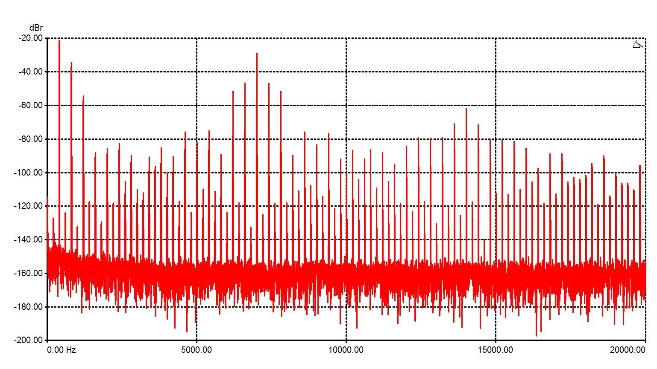

IMD in the frequency domain (FFT)
Here is the same signal in the frequency domain (an FFT)
Not pretty!
Notes:
In the frequency domain – on an FFT – you can see the largest peaks at the two input frequencies. You also see peaks at integer multiples of these frequency (800Hz and 14kHz for example) – this is harmonic distortion. But the thing we want to focus on here are the peaks that are NOT harmonically related.

Slide 16
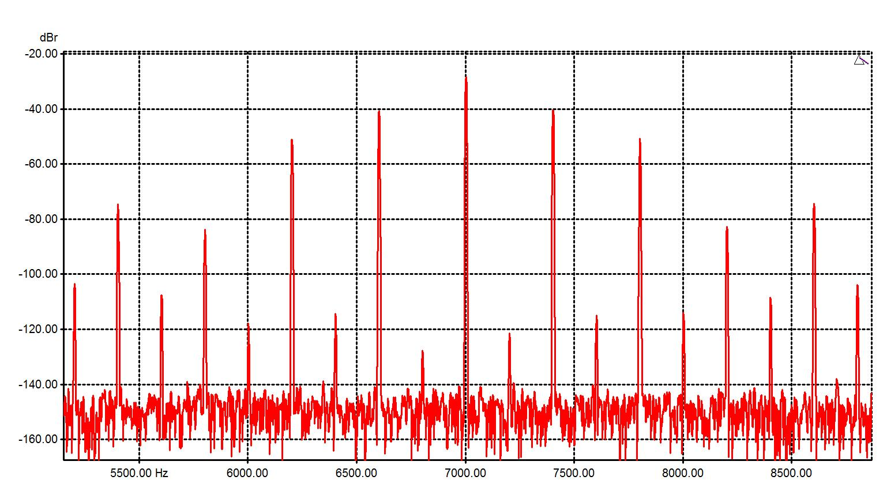
IMD in the frequency domain (FFT)
If we zoom in on the 7kHz peak, we can see peaks – sidebands – at 400Hz intervals. These signals were NOT in the input, they were generated by the nonlinearities of the amplifier. These are intermodulation products.
~-10dB
Notes:
You see peaks at the sum and difference frequencies, every 400Hz in this example. The biggest ones are only 10dB below the signal! (Interestingly, there are also small peaks at 200Hz. I am not sure why…)

Slide 17
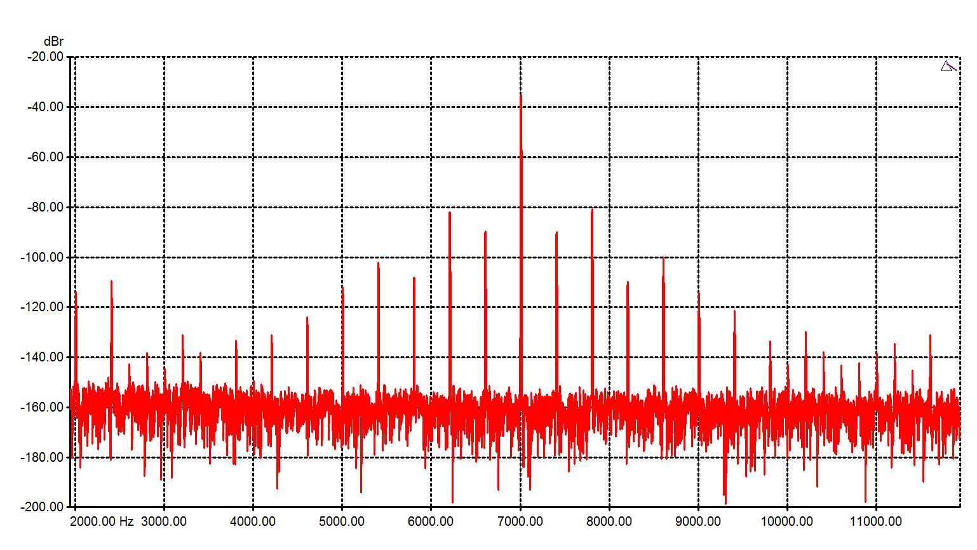

Effect of operating conditions on IMD
If we re-bias this amplifier to a more linear region, things are better
~-42dB
Not as bad!
Notes:
This is the same amplifier, but with the bias set to a more linear operating point. You can see that that the IMD products drop, now around -85dB.

Slide 18
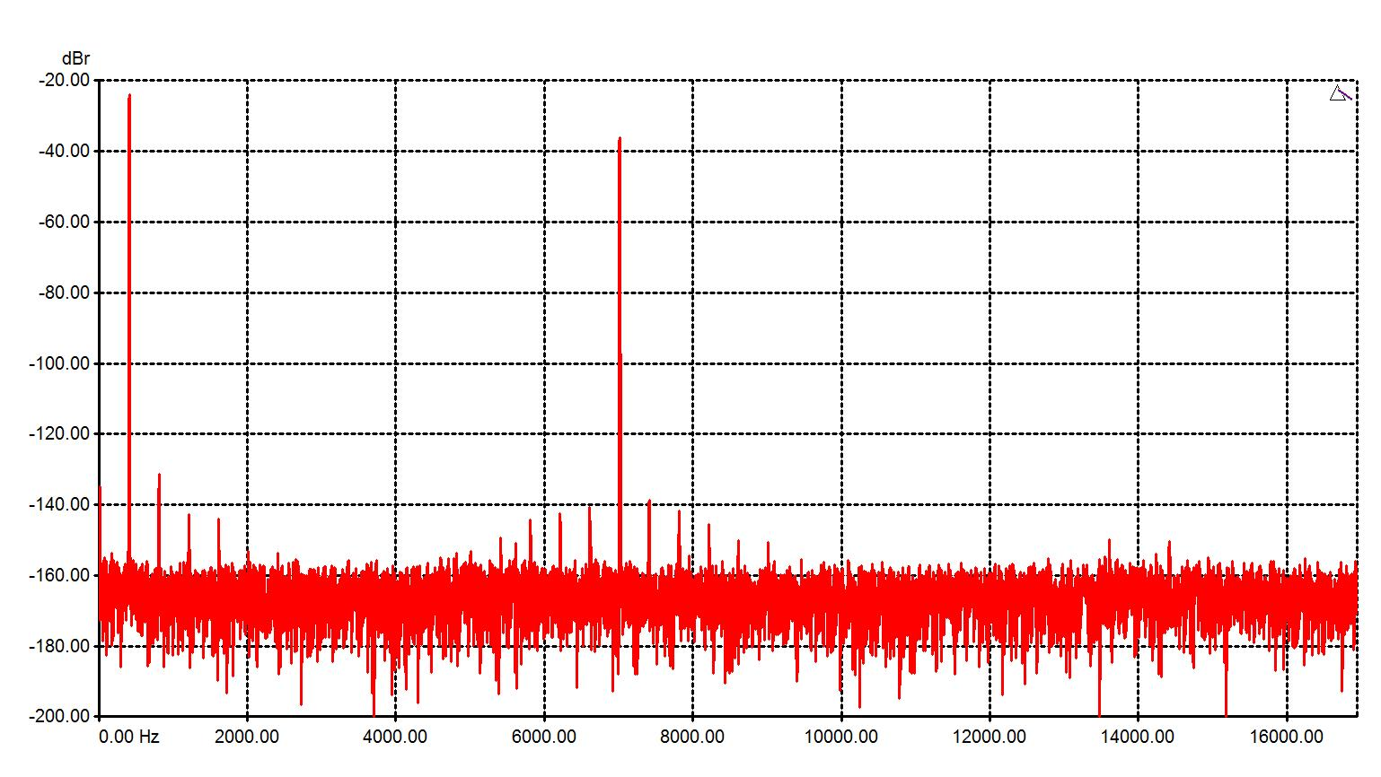
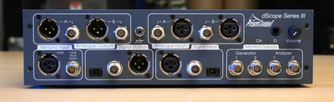
What we really want
This shows what you see in an FFT with very low IMD
< -100dB
Cheating!
Notes:
The biggest IMD products here are about -100dB down, less than 0.001%. This is actually the Prism D-Scope measuring its own output directly.

Slide 19
IMD measurement techniques
Measuring IMD involves applying a two tone input signal, and measuring the amplitude of the undesired output products
Any two tones van be used, but there are two main standards used: SMPTE and CCIF (also called DFD)
SMPTE IMD measurements use a low amplitude high frequency signal and a high amplitude, low frequency signal, usually 7kHz and 60Hz at a 1:4 ratio, and the amplitude of 6940Hz and 7060Hz is measured
CCIF IMD measurements uses two equal amplitude high frequency signals, usually 19kHz and 20kHz, and the amplitude of the resulting 1kHz product is measured

Slide 20
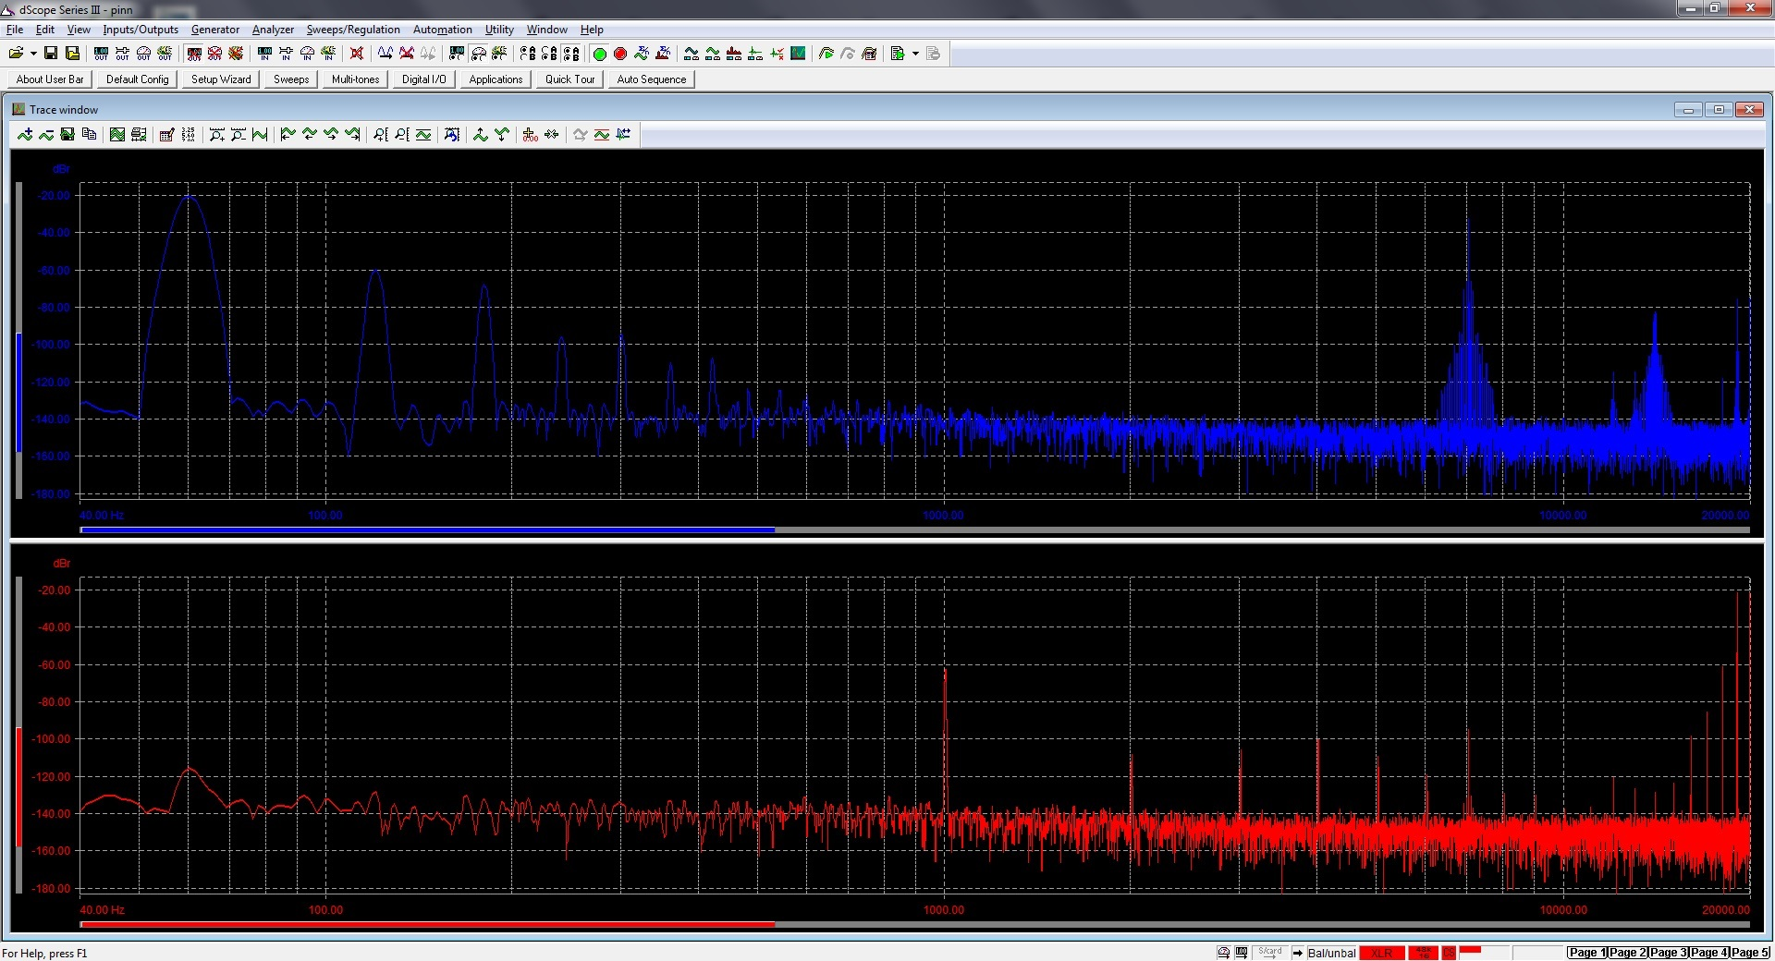
SMPTE and CCIF spectra
Notes:
Here is a screen shot comparing SMPTE (top) and CCIF (bottom) IMD spectra. In the SMPTE plot you can see 60Hz and it’s harmonics, and 7kHz and it’s harmonics, as well as the IMD “fuzz” around them. In the CCIF plot you can see the 1kHz product, and also its harmonics.

Slide 21
Hum Intermodulation

Slide 22
A special case: hum intermodulation
“Hum intermodulation” is a phenomena that occurs in tube amplifiers – most severely in directly heated tube circuits when the cathode is heated with AC
I believe there are three components of hum intermodulation: thermal modulation, filament asymmetry-related modulation, and IMD that is produced from hum coupled into the audio path
Note that ripple on B+ will also intermodulate with the signal
Reference works of Steph Bench and Dmitry Nizhegorodov:
http://diyaudioprojects.com/mirror/members.aol.com/sbench/humbal.html
http://www.dmitrynizh.com/filament-ac-freq.htm
http://www.dmitrynizh.com/filament-ac-harmonic.htm

Slide 23
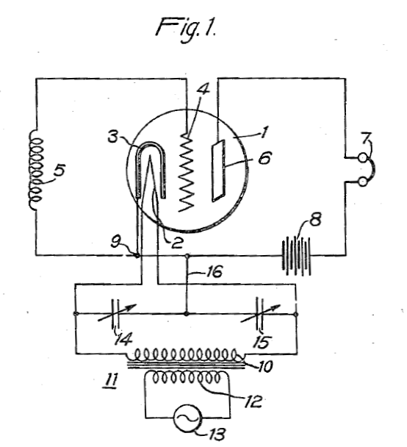
US Patent #2,078,666 – 1937 – The IDHT
“The hum is due, in part, to the variation in temperature of the electron-emitting means and, in part, to modulation of the space current by the magnetic field surrounding the heater element. The hum is also due, to a great extent, to variations in the potential of both grid and plate with reference to the thermionic emitting element or cathode.”
Notes:
I am not convinced that magnetic fields are a big contributor. The capacitors – 14 and 15 – are a form of hum balance. The patent also shows a connection where the center tap of the filament transformer is coupled to ground. There is an earlier patent #1,459,412 for an indirectly heated cathode, but it did not mention AC hum.

Slide 24
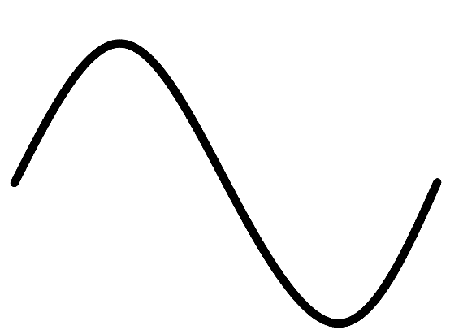
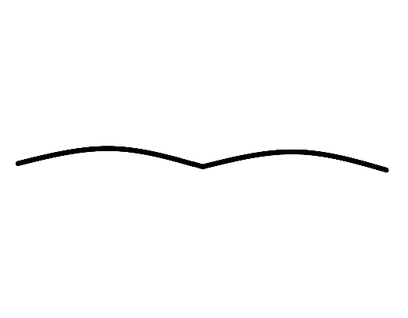
Thermal modulation
When heated with AC, a filament is actually heating and cooling at twice the applied frequency
The gain of a triode amplifier varies with the triode’s transconductance, which varies with cathode emission
When heated with AC, a filament has small changes of emission at double the AC heating frequency, as the filament heats and cools
However… this effect isn’t that big…
It is worst with filaments with low thermal mass, which can heat and cool quickly. It is essentially non-existent with indirectly heated tubes.
Gm
Notes:
You can see that the filament temperature changes ever so slightly over the AC waveform, which causes small oscillations in the gain. How much this happens depends on the thermal “inertia” of the filament, which largely depends on the mass. It’s more of an issue with low mass filaments.

Slide 25
Filament emission
B+
When the filament is heated with AC, twice per cycle, both ends of the filament are at 0V (or at least at the same DC voltage)
At this time, the voltage difference between every point on the filament and grid is equal
-Bias
0V
0V

Slide 26
Filament voltage influences effective bias
B+
As the voltage applied to the filament changes, so does the relative voltage between each part of the filament and the grid
Effectively, the bias voltage is now different at different points on the filament, and one end emits more electrons than the other
If the tube were perfect, the average grid-filament voltage should be the same throughout the AC cycle – and there would then be no hum from this
-Bias
+2.5V
-2.5V

Slide 27
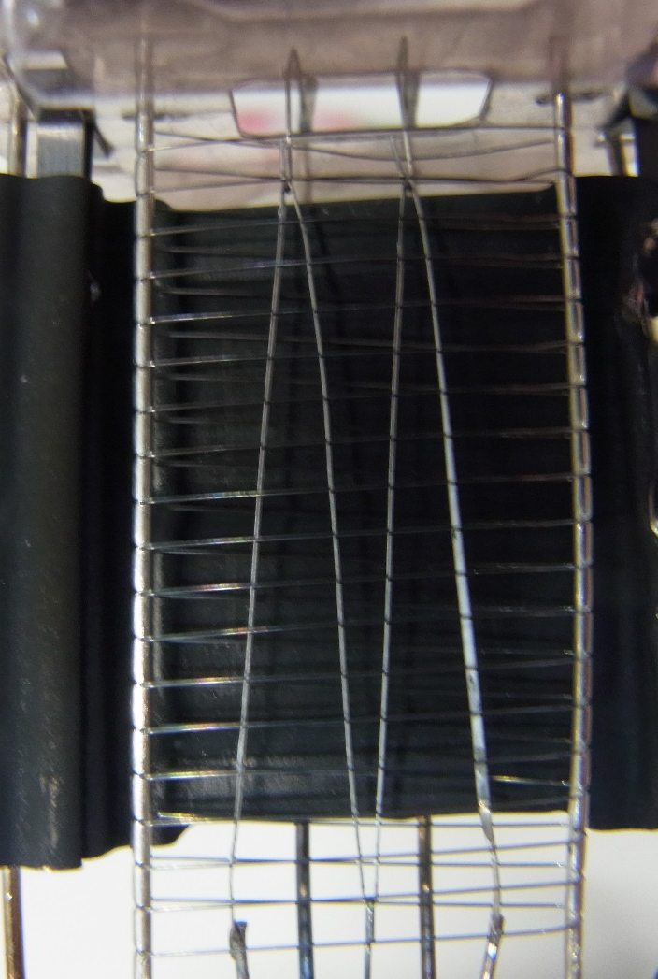
Tubes are imperfect!
A real directly heated triode is far from perfectly constructed!
Filaments are often not symmetrical top-to-bottom and not perfectly centered within the grid structure
Some grid wires may be closer or farther from the filament on one end
Emissivity may vary from one end of the filament to the other
Notes:
This is a 45 triode that I carefully opened up

Slide 28
The result: intermodulation
B+
Asymmetries result in varying emission at different points in the AC waveform
The result is varying gm at different points in the waveform
As before, this gm variation modulates the desired signal
-Bias
+2.5V
-2.5V

Slide 29
Coupled-hum IMD
Any line frequency interference that is coupled into the audio path will also intermodulate with the desired signal, due to harmonic distortion in the amplifier
Coupling can be capacitive – like AC mains wiring run next to signal wiring – or magnetic, especially between power supply transformers or chokes and input or interstage transformers
Ripple on B+ also causes this
This is probably the main form of hum IMD in indirectly heated tube circuits?

Slide 30
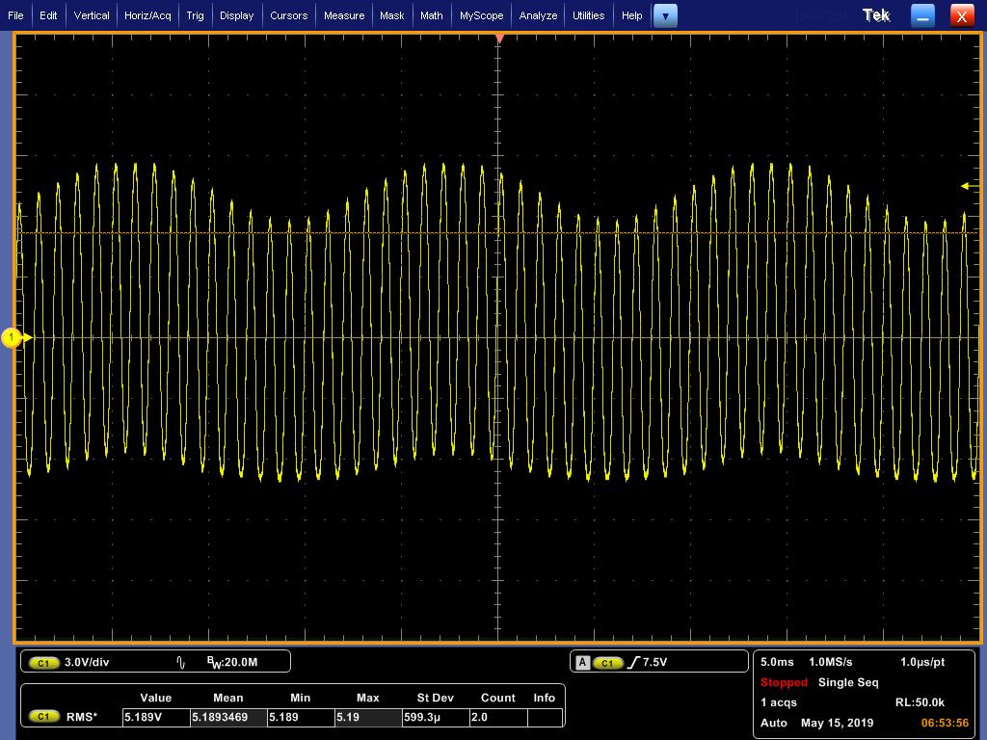
Harmonic distortion induced hum IMD
You can see the effect here. This shows a 1kHz signal with a huge amount of 60Hz hum.
The amplitude of the 1kHz signal is being modulated by the 60Hz signal.
Notes:
This is an extreme amount of hum – just to show how they intermodulate.

Slide 31
Let’s hear this distortion…

Slide 32
Listening demonstration
I built a circuit to demonstrate IMD - especially hum IMD
I hoped to be able to demonstrate this using a real triode, but the effects are too subtle. So I built a circuit that can generate extreme levels of IMD.
The circuit uses multiplier ICs to amplitude modulate the music signal with an adjustable sine wave signal
This generates pure IMD – and very little harmonic distortion

Slide 33
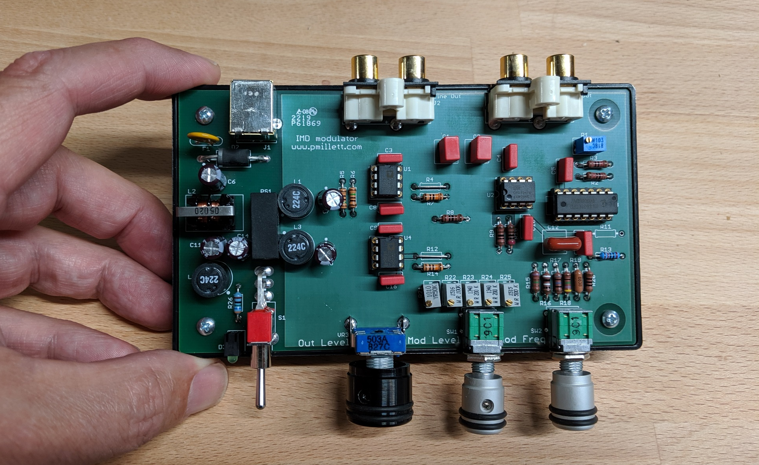
The “IMD Modulator”
Notes:
Here’s the distortion generator.

Slide 34
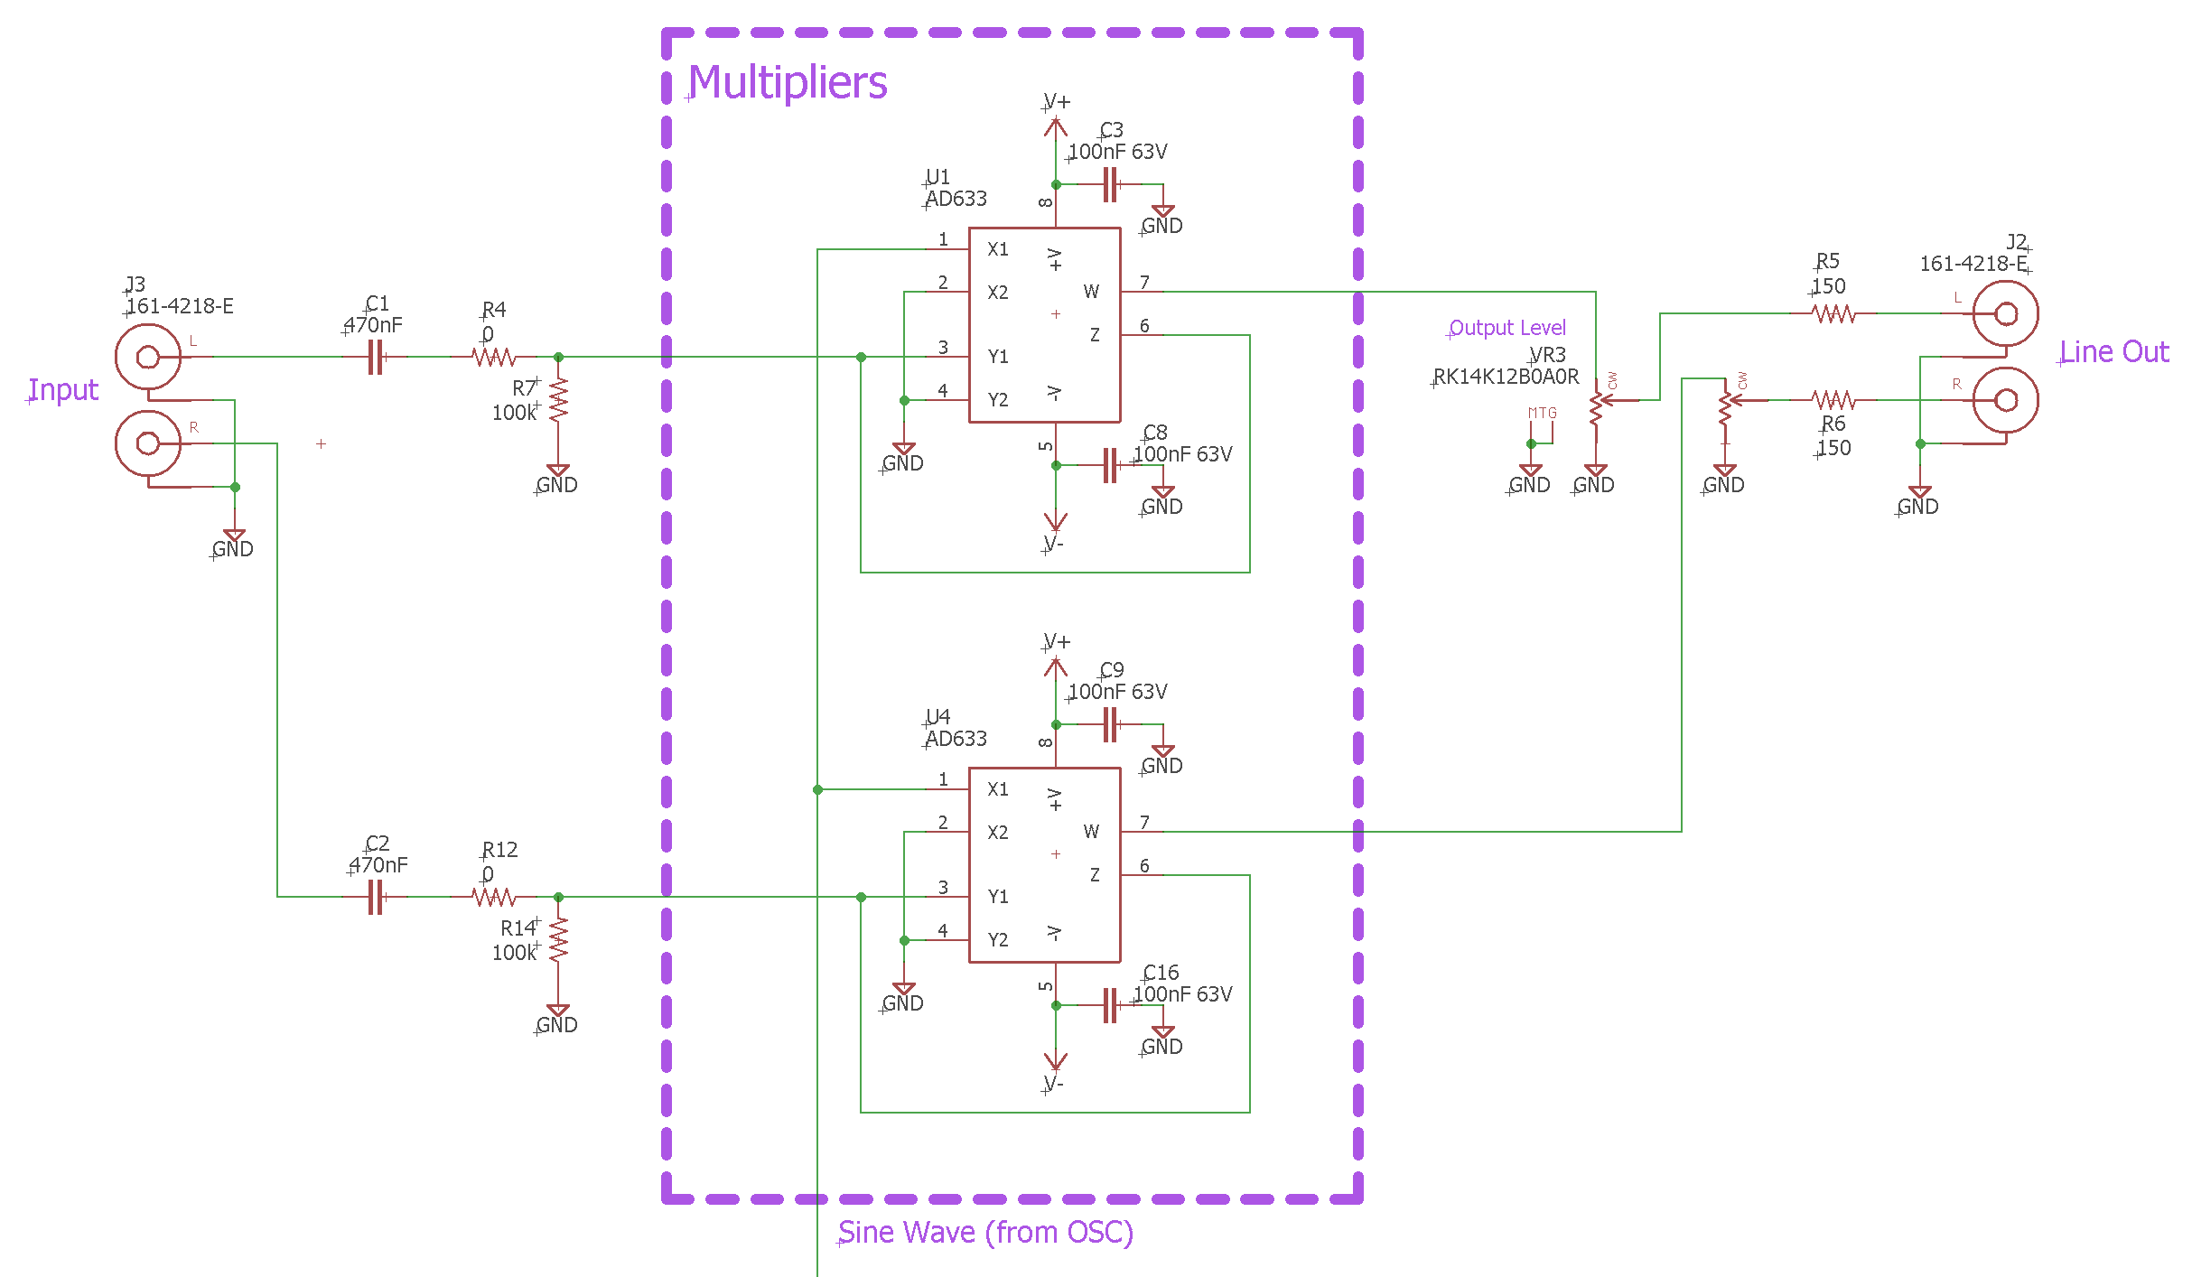
The circuit - Modulator
Notes:
The audio passes through two analog multiplier ICs set up as amplitude modulators.

Slide 35
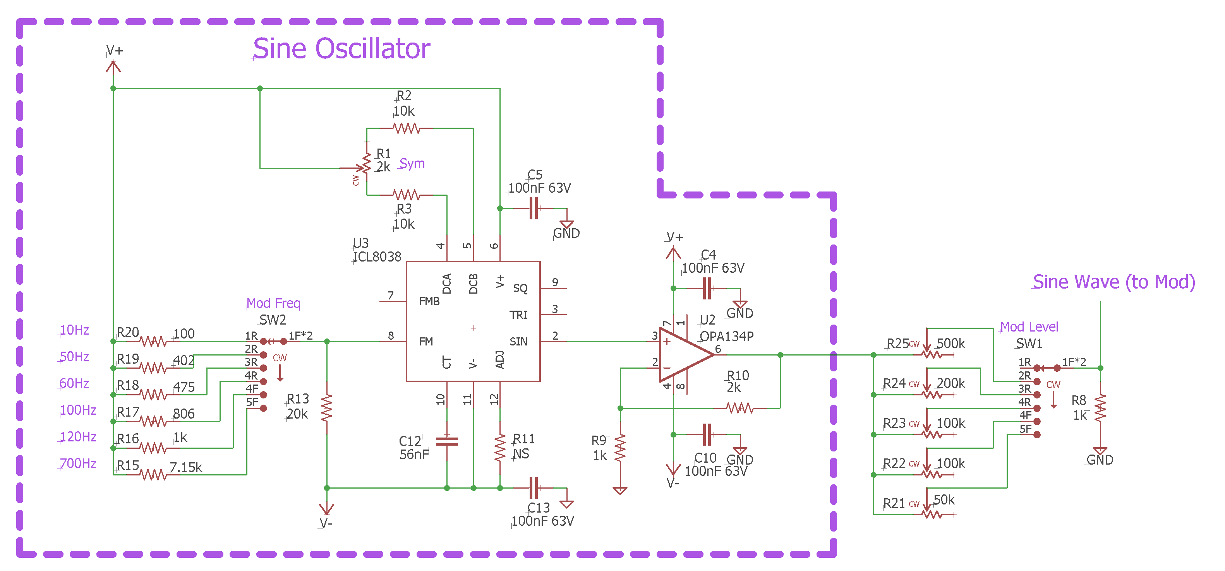
The circuit – Sine Oscillator
Notes:
A sine wave is generated using the old ICL8038 IC to provide the modulating signal. Different fixed frequencies are selectable, as are different modulation levels.

Slide 36
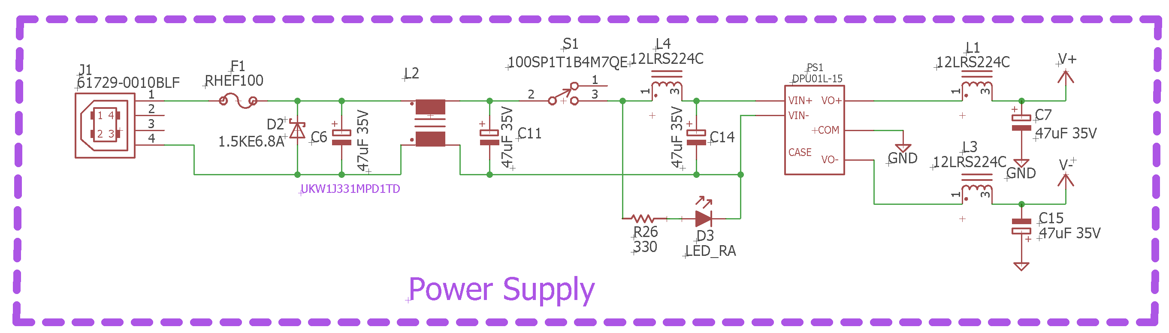
The circuit – Power Supply
Notes:
A DC/DC converter generates +/-15V from 5V USB power

Slide 37
Settings
The IMD modulator has two adjustments: Oscillator frequency, and modulation depth (as well as an output volume control)
The frequency is selectable around normal line frequencies (and 2x those frequencies), as well as one low frequency (around 10Hz) and one high (around 700Hz)
The modulation level (level of the first sideband) can be adjusted between none and -8dB, which is 50% IMD
I’ll use audio generated from my laptop via a USB DAC for the demo
Notes:
Selections: 10Hz, 50Hz, 60Hz, 100Hz, 120Hz, 700Hz. None, -60dB (0.15%), -30dB (4%), -20dB (14%), -12dB (32%), -8dB (50%) first product amplitude. -8dB is about 100% modulation.

Slide 38

Listening to Sine Waves?
Most of us don’t spend a lot of time listening to sine waves. OK, some of us nut cases might…
IMD is easily heard on a sine wave, so…
We will start with a sine wave
Notes:
You can hear the differences between different frequencies and modulation depth. Selections: 10Hz, 50Hz, 60Hz, 100Hz, 120Hz, 700Hz. None, -60dB (0.15%), -30dB (4%), -20dB (14%), -12dB (32%), -8dB (50%) first product amplitude. -8dB is about 100% modulation.

Slide 39
Music
So now we’ll try some music…
I was surprised that some types of music that I expected to be less… annoying… with IMD added were not as easy to distinguish as I thought
If it’s bad enough obviously you can hear it on anything
Notes:
Selections: 10Hz, 50Hz, 60Hz, 100Hz, 120Hz, 700Hz. None, -60dB (0.15%), -30dB (4%), -20dB (14%), -12dB (32%), -8dB (50%) first product amplitude. -8dB is about 100% modulation.

Slide 40
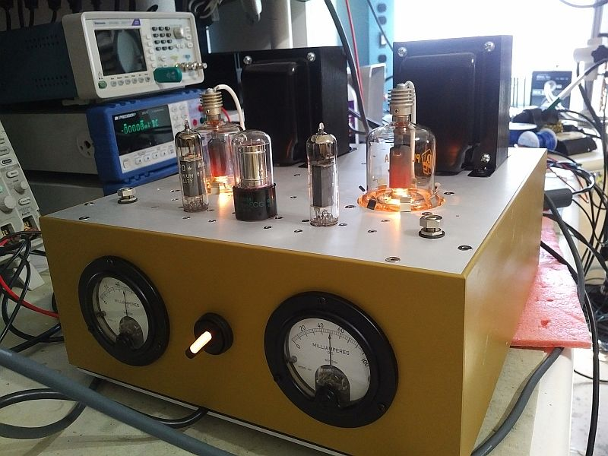
That’s it…
Questions?
Comments?
Notes:
(That’s my SE PL177 amplifier)

